Slide 1
Analysis of the Housing Market in Two US Cities from 2020-2022
By Real Estate Investment Group

Slide 2
Real Estate Investment Group Members
Nikhil Muthuvenkatesh- Intermediate level of programming in Python, background in sales/engineering to help market the final product, some knowledge of the real estate market
Rohan Ukkalam - Intermediate level of programming in Python, some experience with programming in Java and C.
Seyi Oyesiku - Intermediate level python programmer, my background is networking and supply chain logistics. Other familiar programming languages include C and Python.
Luqing Qi - Intermediate level Python programmer, my working experience coming from the healthcare industry.

Slide 3
Project Goal
The goal of this project is to use real estate data from 2020-2022 to train a model that is able to predict real estate pricing in the future. We will attempt to use supervised learning with this model by giving our model the labels and outputs that were expected in the training set. This will allow us to use the factors that we trained the model with to find out what the pricing of housing would look like in the cities we chose.
The end result of this product will take a current table of listings, and then try to populate the dataset with pricing that it predicts for those houses/apartments. The model will use the columns in the dataset such as neighborhood, year built, and any other predictors that we used in the training phase.

Slide 4
Accomplishments
Thus far, we have acquired realtor data from Kaggle, and created a mask to filter only data from Philadelphia and New York real estate. This data has been stored in a local Pandas Dataframe.
We have identified the unique values in all of our current data features and have identified all the NaN values in our dataset.
We have looked into various real estate websites, searching for publically available data and public APIs. After this search and considering the available options, we have submitted a request to gain access to the Zillow API, which we will use to acquire more data that would be helpful for training our model.
All of our work including this presentation are uploaded to this github repository: https://github.com/Unlessitoldyou/DSCI-Capstone1/projects?query=is%3Aopen

Slide 5
Current Data
The current dataset we have was procured from Kaggle, and is a recent compilation of real estate listings across the United States. We’ve filtered and modified the dataset such that it only contains the geographical locations we are interested in, and a column mostly comprised of NaNs has been dropped. Data features present in the data set include:
Status
Price
Bed
Bath
Full_address
House_size
sold_date

Slide 6
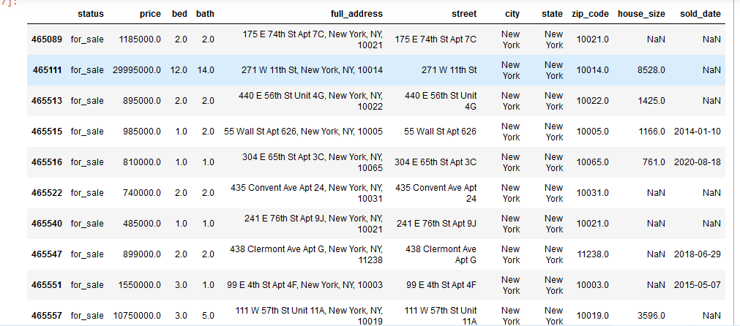
Current Data

Slide 7
Future Dataset Expansion
We have requested access to the Zillow API. This will be important to our project because if we are able to access listings in the past and currently, we will have more data than we already have, and should be able to train our model better. We also plan to use the Redfin API if Zillow’s does not have the information that we need.
There are a number of NaN values in our data, so we have a few options on how we would like to handle these. Some of our columns will require different strategies, so we will have to decide what to apply where. We plan to either web scrape to find the missing values, drop some of those values entirely, or we use a default value to populate these values.

Slide 8
Next Steps
We plan to next consolidate further data through API usage, which should be finished by the next week.
Using the data gathered through the API, we will compile all the data we’ve gathered into a clean, processed data set
With this completed data set, we can begin further Exploratory Data Analysis and Data Visualizations

Slide 9
Thank You

